Slide 1

P peline
The Data
Byte 3
© Jennifer Mankoff
The Data Pipeline; HCII; Spring 2014

Slide 2
Byte 3
Learning Goals:
Explore the value of mobile data
Address data quality issues
Work with location based data
Learn about how to set up a data store in Appspot

Slide 3
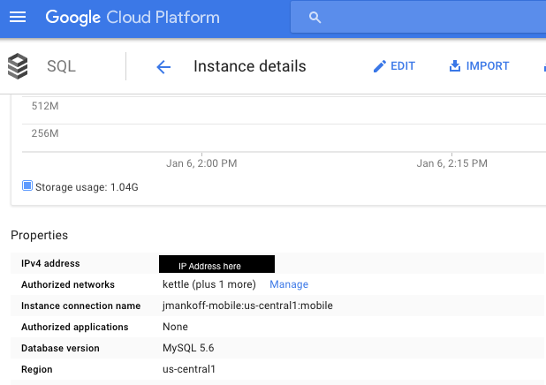
Setting up a Datastore
Google has great documentation (https://cloud.google.com/appengine/docs/python/cloud-sql/)
You need to customize the access permissions
Cloud Storage
Step 1: Request an IP address from Cloud (‘CloudIP’)

Slide 4

ONLY if you were not in the study
Google has great documentation (https://cloud.google.com/appengine/docs/python/cloud-sql/)
You need to customize the access permissions
Cloud Storage: Cloud IP
Step 2: Give access permission to the ‘AWAREIP’
Aware Server AWAREIP = 80.69.77.149

Slide 5
For everyone
Google has great documentation (https://cloud.google.com/appengine/docs/python/cloud-sql/)
You need to customize the access permissions
Cloud Storage: ‘CloudIP’
Also give access to yourself…

Slide 6
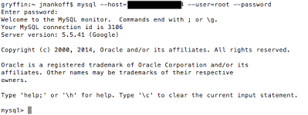
Setting up a Datastore
Google has great documentation (https://cloud.google.com/appengine/docs/python/cloud-sql/)
You need to customize the access permissions
Cloud Storage: ‘CloudIP’
Step 3: Test your connection to CloudIP

Slide 7
Setting up a Datastore
Google has great documentation (https://cloud.google.com/appengine/docs/python/cloud-sql/)
You need to customize the access permissions
Cloud Storage: ‘CloudIP’
CREATE USER 'newuser'@’AWAREIP' IDENTIFIED BY 'password'; GRANT ALL PRIVILEGES ON byte4.* TO 'newuser'@’AWAREIP';
Step 4: Use that connection to set up further permissions for AWARE

Slide 8
Loading the data
Mysql --host [ip] --user=[user] --password=[password] [database] < [file.sql]
[ip]: The IP of your cloud database
[user]: The username you created for your cloud database
[password]: The password you created for your username
[database]: The database the data should be imported to [file.sql]: The name of the sql file to import

Slide 9
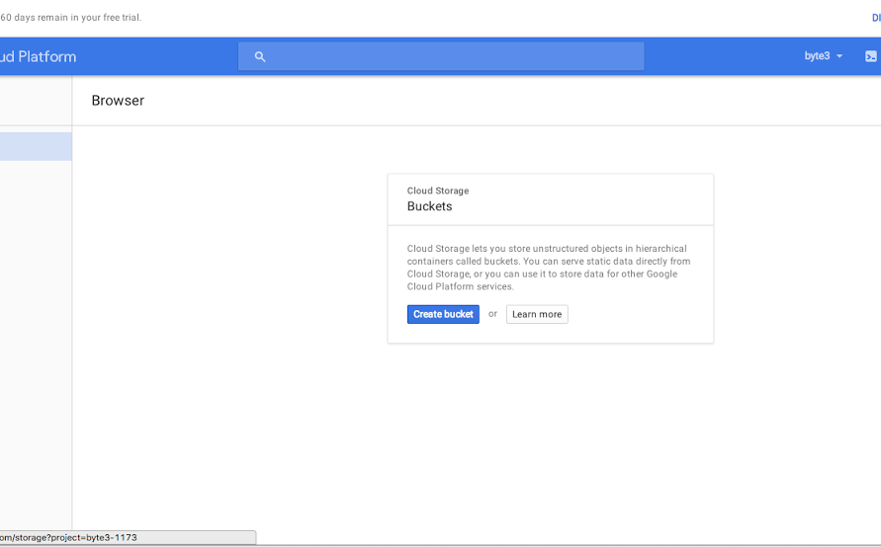
Or use a GUI

Slide 10
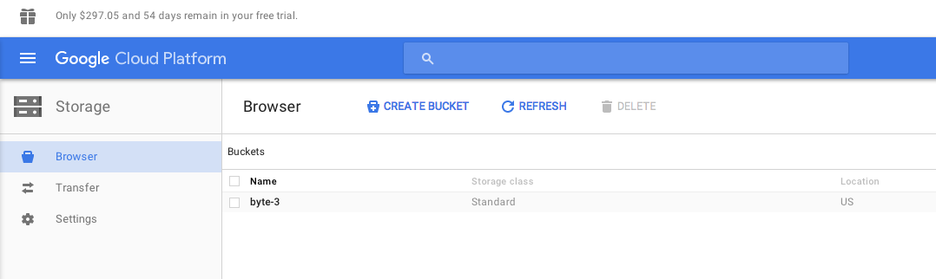
Create a bucket (byte3 here)

Slide 11
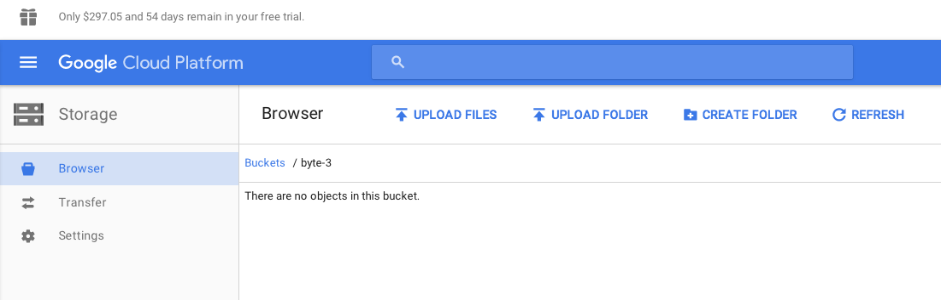
Upload the sql dump file

Slide 12
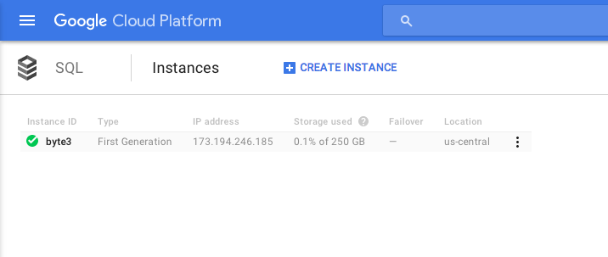
Now click on byte3

Slide 13
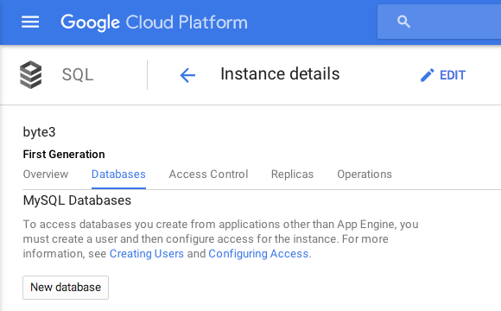
Create a database in it

Slide 14
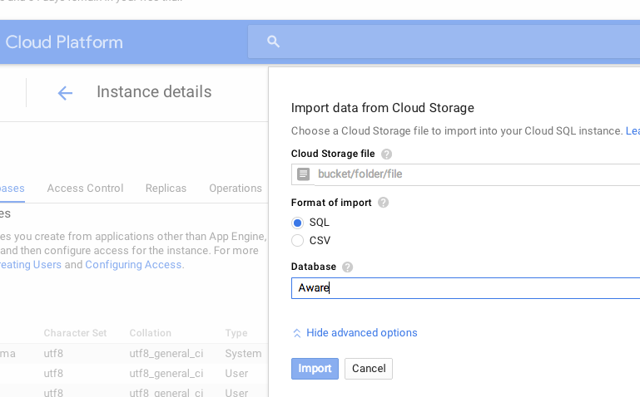
Create a database in it

Slide 15
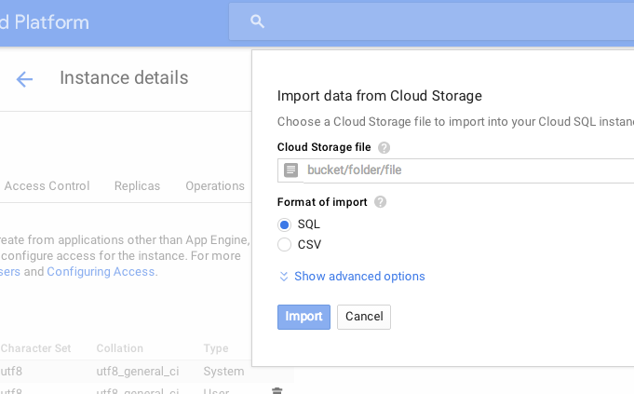
Import your data

Slide 16
Accessing MySQL from python
db = MySQLdb.connect(unix_socket='/cloudsql/' + _INSTANCE_NAME, db=_DB, user='root')
cursor = db.cursor()
Helper function – prints result to log
self.make_and_print_query(cursor, 'SHOW TABLES', 'Show the names of all tables')
Helper function – returns result as list
rows = self.make_query(cursor, query)

Slide 17
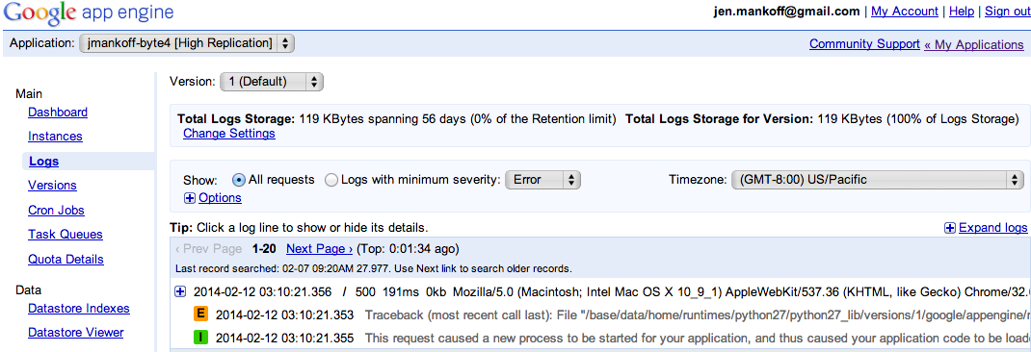
Debugging this assignment
Server side debugging is a bit of a pain
Google helps though – provides access to logs

Slide 18
More Debugging
My helper function prints recent SQL commands to log and catches SQL query errors
You may also see errors show up in the [projectname]-byte4 browser window

Slide 19
What do can need to do with mobile data?
Cleaning: can you tell when the phone is off? (not a focus of this byte)
Organizing: identifying common locations (what the byte walks you through)
Associating: connecting activities to other context (we explore location + activity, homework is to explore time + activity)

Slide 20
Basic Hand In Expectations
Improve the location binning by picking a better epsilon
Explore relationship between time and activity (your main job on this assignment)
Display the results (more nicely than I do!)

Slide 21
Advanced Hand In Expectations
You could design a study that looks at something besides activity
Talk to me about goals & outcomes that make sense

